Slide 1
INFO 250 Information Visualization
Week 2B: Ontologies of visualization
Classification of Visualization (II)
Lab time

Slide 2
Review of last class
Visualization can be classified by the number of data variables that it represents.
We discussed different data types. Numerical and categorical data are two data types that are most frequently involved in visualization design.
We discussed some basic ideas about one- to three-dimensional visualizations.
Two-dimensional visualizations are the most common visualization type.
The dimensions of visualization and data are ideally the same.
Dimensionality could determine what story can be told from the visualization.

Slide 3
Overview of this class
We will talk about some data sources that you may need for the final project.
We will talk about specific types of graph types on the following aspects.
We will apply an analytical framework for the preparation of this week’s project.
About 20 minutes of lab time:
You can work on your project and/or ask questions about the project.
You can also talk/network with your classmates.
Feel free to leave if you do not need the time.
TA and I will make rounds to answer any questions you may have.

Slide 4
Data repository list
It is available at the course shell and will be supplemented during the coming weeks.
List:
Information is beautiful: https://informationisbeautiful.net/data/
Data.gov: https://www.data.gov/ (and open government data portals in other countries!)
Fivethirtyeight Data: https://data.fivethirtyeight.com/
Our world in data: https://ourworldindata.org/
You can also think about scraping data from websites or using their APIs to acquire data.
Find a topic/dataset that you are interested in and/or beneficial for your future career!

Slide 5
Examples of graph types
Pie chart
Bar chart
Line chart
Scatterplot
(Small multiples)

Slide 6
Analytical framework to analyze graphs
What visual patterns are used in the graph?
What data types are represented in the visual patterns?
What are some general relationship between data points (story) one can draw?
What are some pitfalls of the graph?
How to address the pitfalls?
Notes:
Ideal framework to use
Visual patterns – x axis y axis legend
Data types – numerical, categorical
Relationship - stories

Slide 7
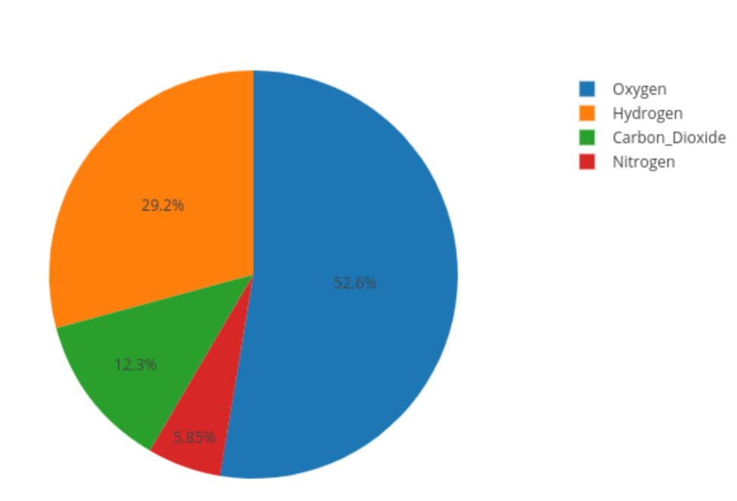
Pie Chart (I)
Pie chart displays how the size of each category (by the size of the slice of pie) adds up to the whole population.
Visual pattern: size (angle) of the circle
Data: Numerical
Annotation is important for pie chart!
Ratio is normally displayed, if not combined with raw numbers.

Slide 8
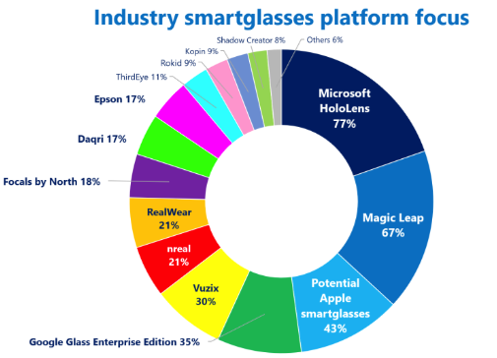
Pie Chart (II): Pitfalls
Pie chart (or donut chart) is based on three assumptions:
Categories should be mutual-exclusive;
All categories of the population are ideally included;
Ratios of all categories should add up to 100%.
If any assumption is violated, the data is better visualized in bar chart.
https://viz.wtf/
Notes:
Problems with this one – ratios do not add to 100% they should be mutually exclusive

Slide 9
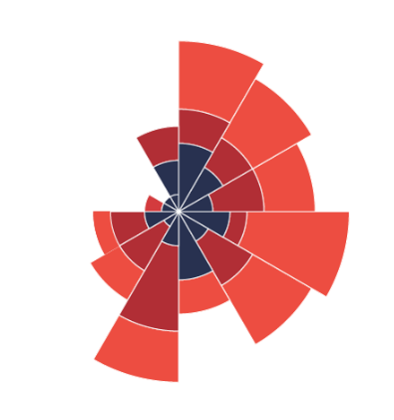
Pie Chart (III): Alternatives
Polar-area chart is often used in different ways from pie chart in the sense that the size of slice does not have any meaning.
Rather, polar-area chart uses other visual patterns: (1) thickness of shape and (2) group of shape.

Slide 10
Histogram vs. Bar chart
Histogram displays the distribution of values in a single data variable:
Visual pattern: Size (height) of the bar
Data: Numerical
Bar chart shows the size of an observation:
Size (height) of the bar
Data: Numerical
Think about how bar chart should be used differently than pie chart.
Notes:
Pie chart assumes the summing up of individual objects/categories into the total group.
Bar chart focuses on the comparison between objects and categories.

Slide 11
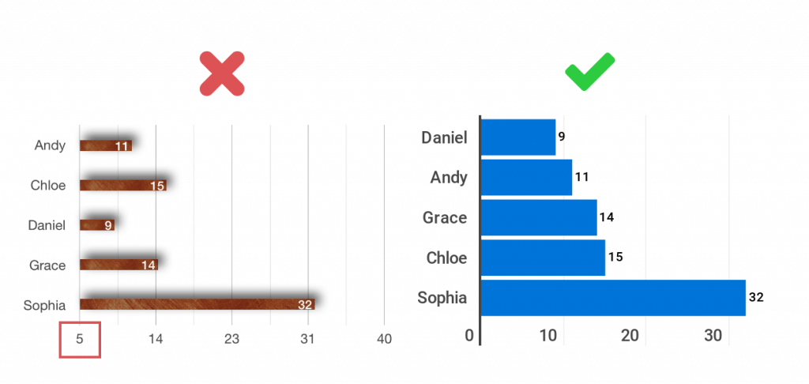
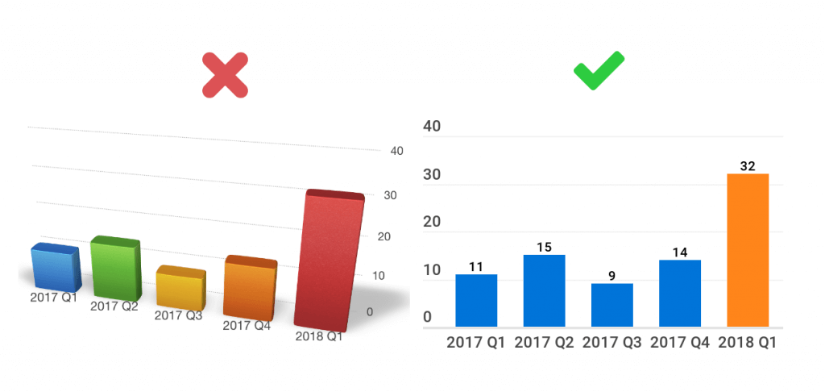
Bar chart (I): Pitfalls
Do not cut axes:
Tufte principle: proportional representation of numbers!
This applies to nearly all graph types (1) with linear scale and (2) the proportion of numeric values bears meanings.
Avoid using 3-D representations when not necessary.

Slide 12
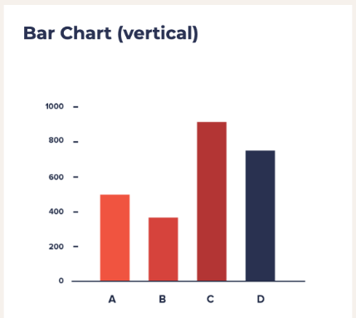
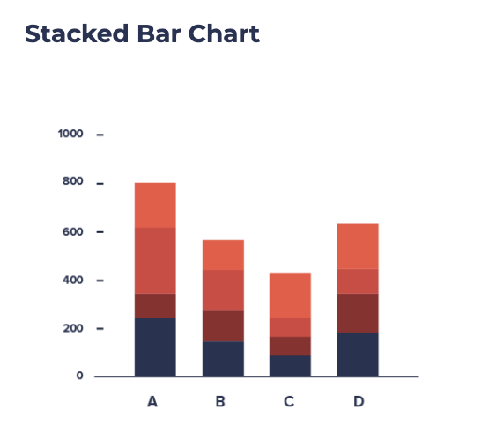
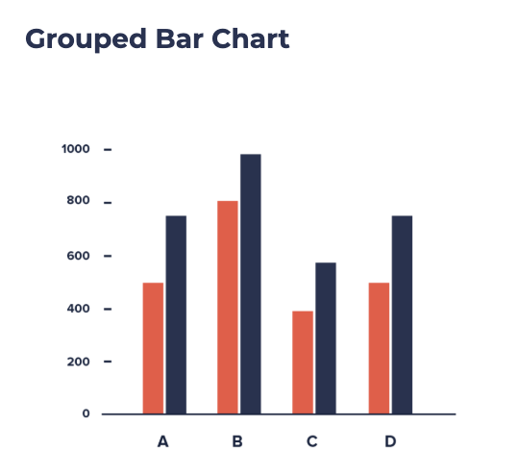
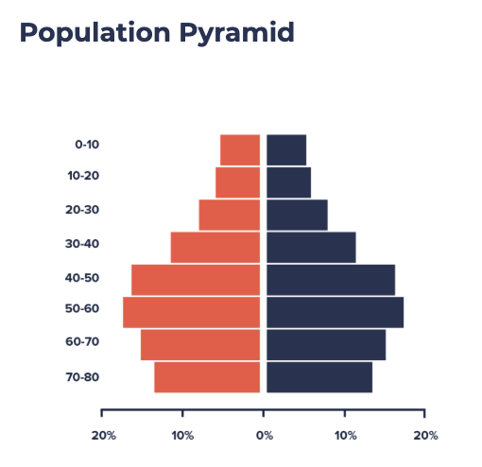
Bar chart (II): Grouped, Stacked and Opposite bar charts (that are not 1-d)
What different stories can the latter three graphs tell?
Notes:
Stacked: summable but not comparable
Grouped: Comparable between groups and between observations
Opposite: can do both compare and sum, but can only support two groups well

Slide 13
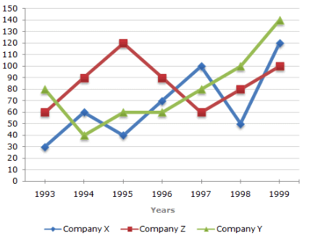
Line chart (I)
Line chart uses the line (connected dots) to draw the pattern of an observation or several observations over timeline or some other categories.
Visual pattern: x- and y-axes…
Data: Datetime or categorical (x) and Numerical (y)
For two-dimensional visualization, categorical or timeline data is conventionally plotted on the x-axis.

Slide 14
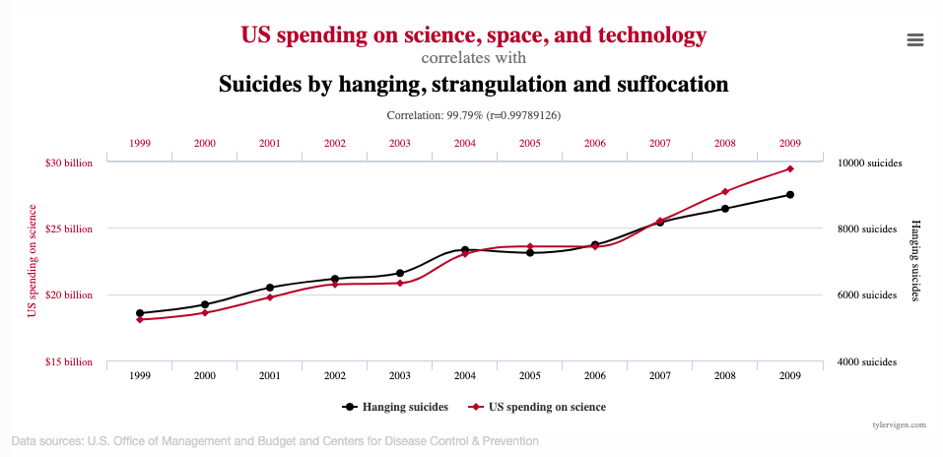
Line chart (II): Spurious correlation
https://www.tylervigen.com/spurious-correlations

Slide 15
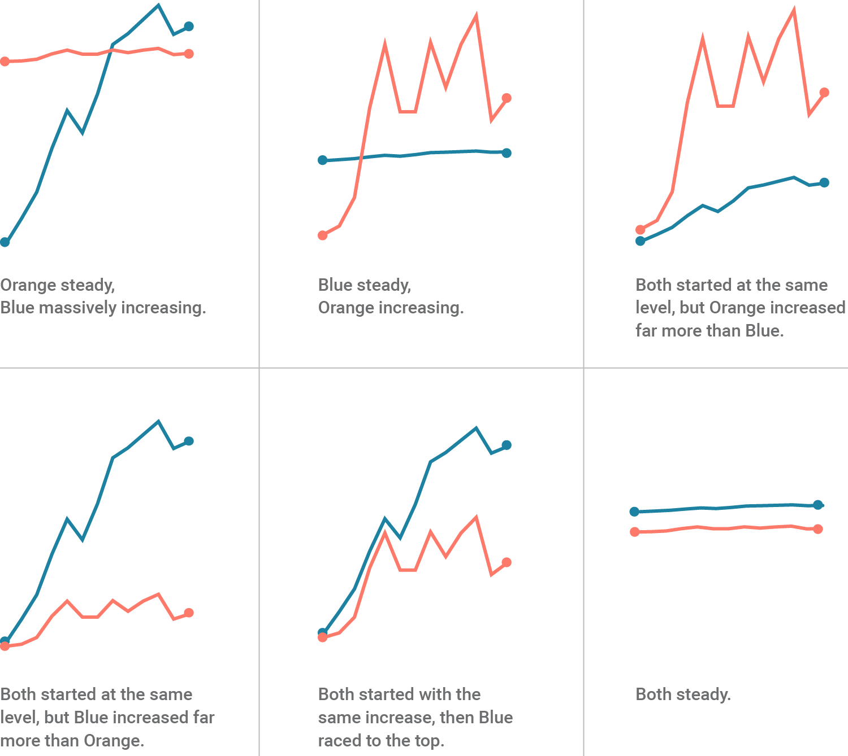
Spurious correlation (I): How to avoid?
To avoid spurious correlation, we should NOT:
Plot unrelated things together;
Using two y-axes in any graph;
Cut numerical axes in any graph;
Use Pareto chart (https://datavizproject.com/data-type/pareto-chart/)
https://blog.datawrapper.de/dualaxis/

Slide 16
Spurious correlation and Big data
Spurious correlation (some events are correlated but not causally related) is a major potential problem for big data analysis, because when a dataset is large enough, everything could be correlated with everything. (https://link.springer.com/article/10.1007/s10699-016-9489-4)

Slide 17
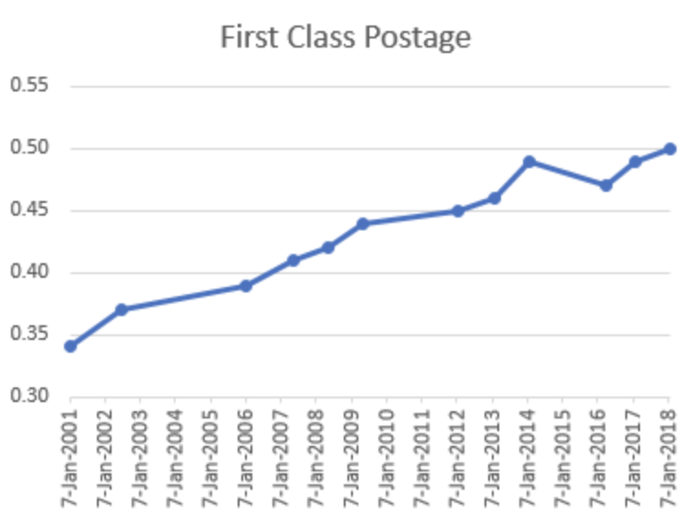
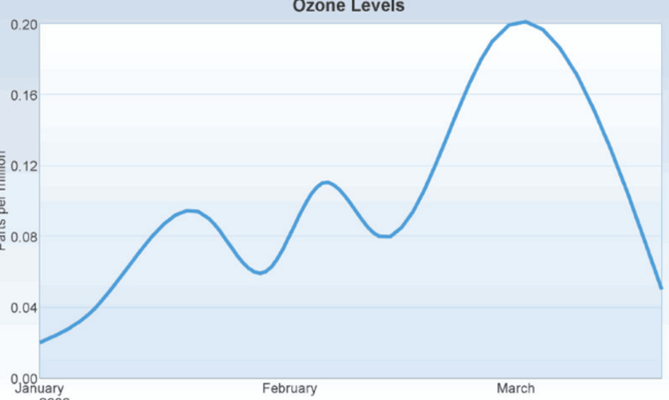
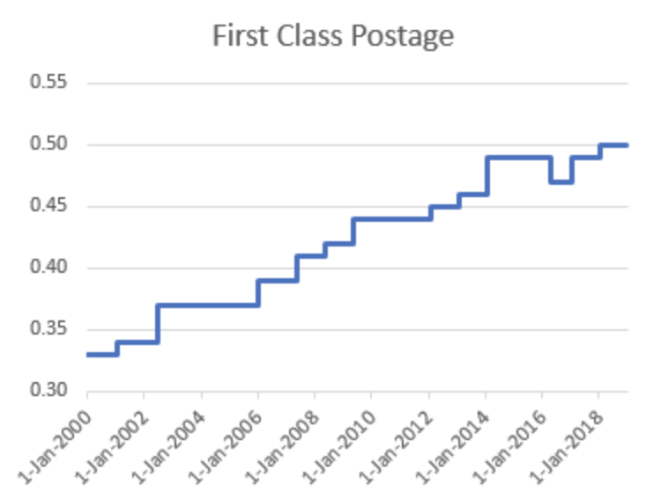
Stepped, curved, and dotted line charts
Notes:
Stepped chart give the impression that the value remains stable.
Curved chart is lack of the context of where the changing point is. It aims to show the general pattern of change.
The straight line give the impression that changes happen gradually.

Slide 18
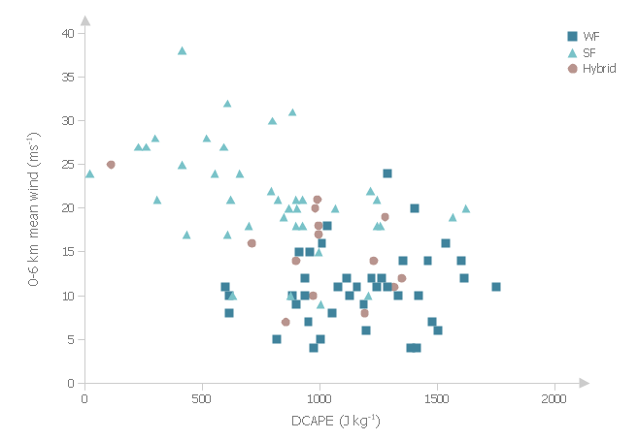
Scatterplot (I)
Scatterplot plots two aspects of objects in a two-dimensional space.
Visual patterns: x- and y-axes…
Data: In most cases, both axes should be mapped to numerical data.*
Scatterplot is frequently used in correlation and clustering analyses.

Slide 19
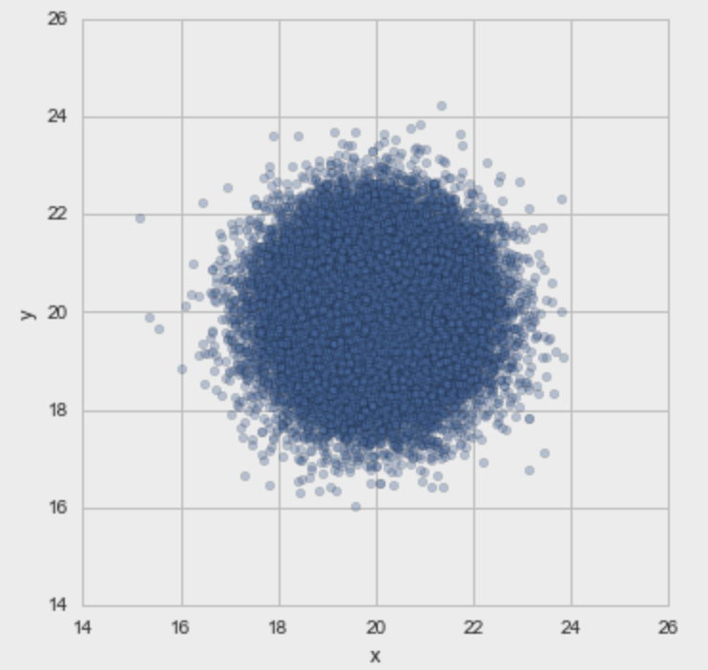
Scatterplot (II): Information overload
As compared to other two-dimensional graphs, scatterplot can represent much more information, especially more observations.
However, this often causes the problem of information overload, which makes it difficult to understand the data.

Slide 20
Scatterplot (III): Information overload
Some solutions to information overload in scatterplot:
Use the visual pattern of transparency.
Use extra graphs to offer the summary of values.
Use small multiples.
Scatterplot may not be the correct answer to all data!
Such as data with too many entities and data variables with very uneven distributions.

Slide 21
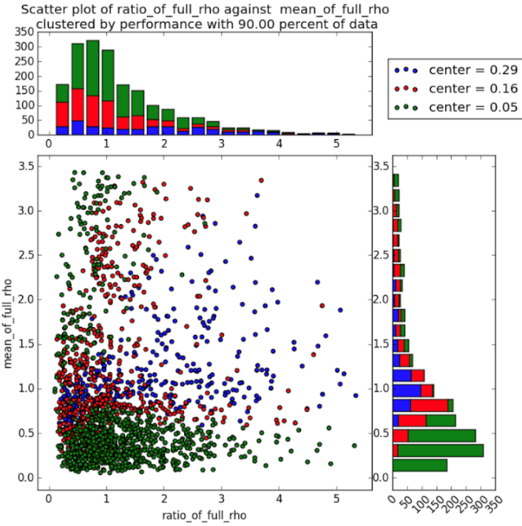
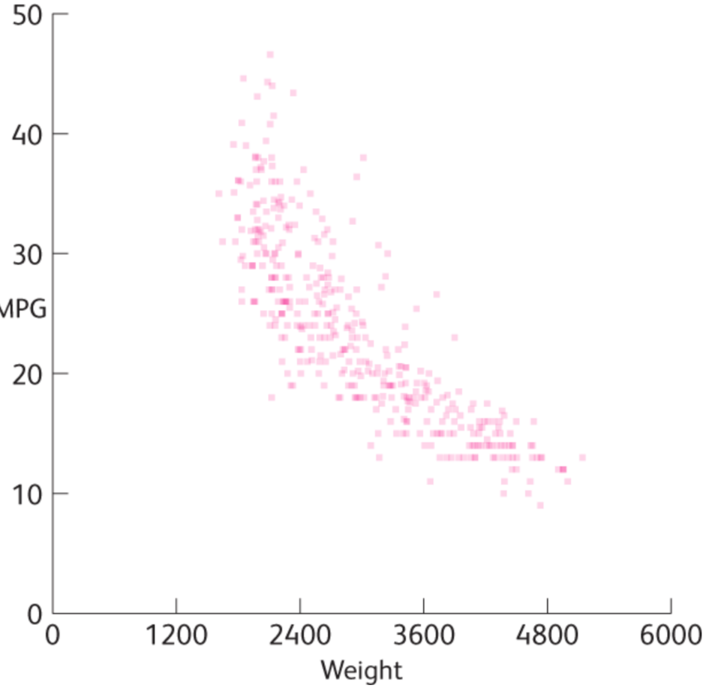
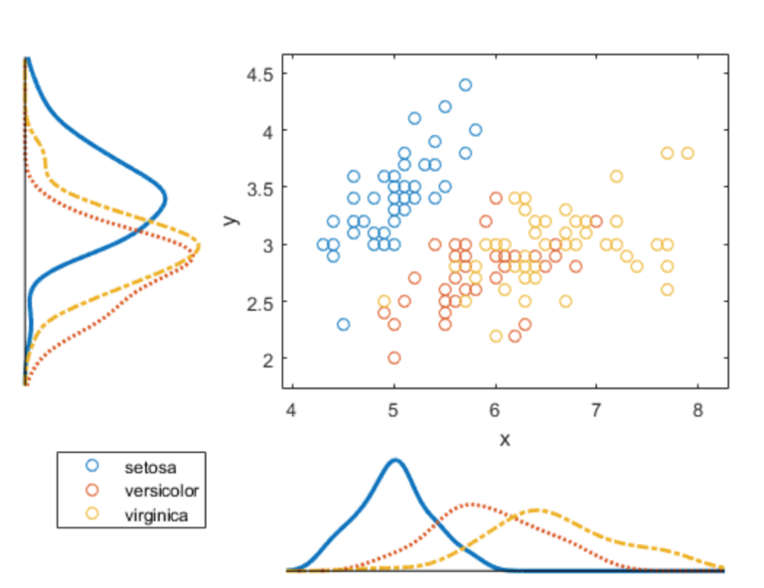
Scatterplot (IV): solutions

Slide 22
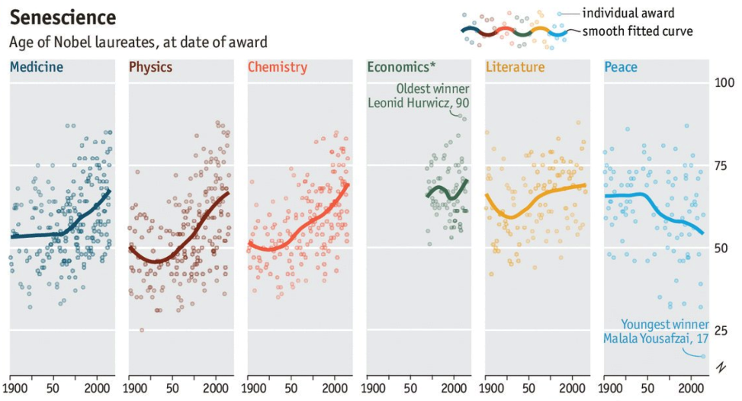
Small multiples (I)
“A small multiple (sometimes called trellis chart, lattice chart, grid chart, or panel chart) is a series of similar graphs or charts using the same scale and axes, allowing them to be easily compared.”
https://en.wikipedia.org/wiki/Small_multiple
https://twitter.com/ECONdailycharts/status/782997404547223552

Slide 23
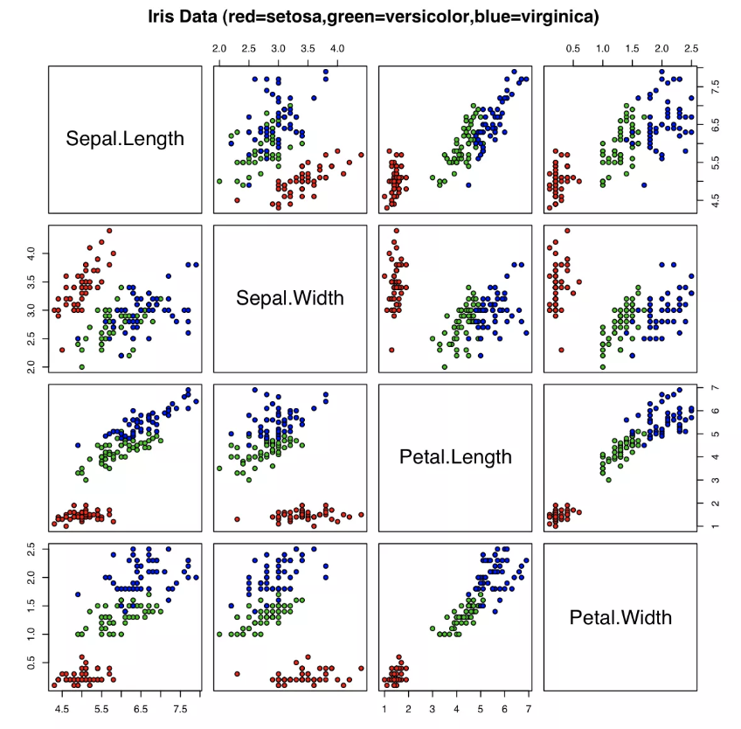
Small multiples (II)
Small multiples, as a meta-type of graph, can be applied to different visualization types, such as scatterplot, line chart, and bar chart.
Besides making inter-group comparisons, another use of small multiples is to give a comprehensive summary of the dataset.

Slide 24
Project 1A: Using RAW to explore visualization types
http://app.rawgraphs.io/
Deadline: Oct 3 (Sunday) 11:59PM

